Slide 1
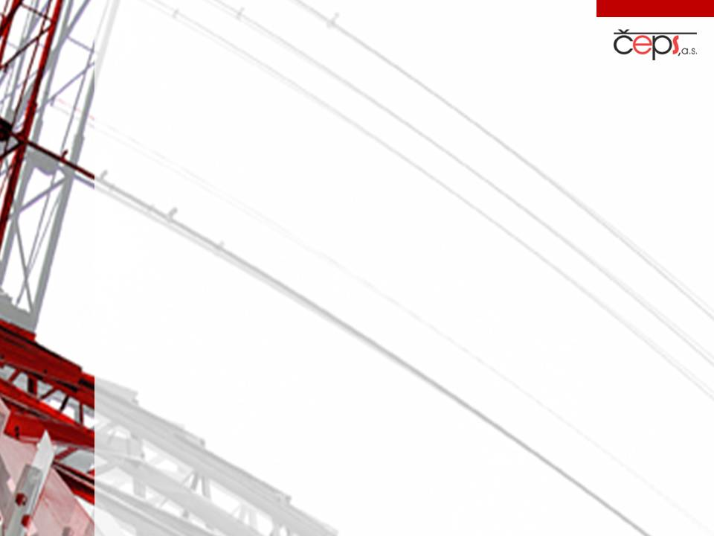
Challenges for the electricity sector from a TSO perspective
Zbyněk Boldiš
Member of the Board
ČEPS, a.s.
ASD Annual Convention – Knowledge Café
24 April 2014

Slide 2
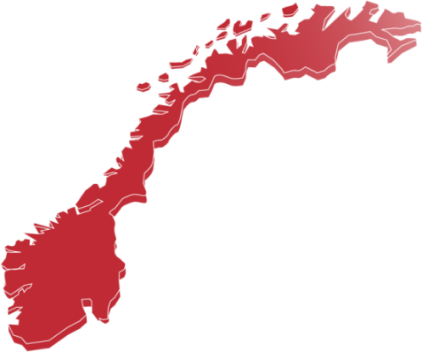






























ENTSO-E: 41 TSOs from 34 countries
  European Network of TSOs for electricity
  ~ 500 million people served
  650 GW generation capacity
  230 000 km of high voltage lines
  Demand: 3 000 TWh/year
  Cross-border exchange: 380 TWh/year
  Mission
  Security (operation of transmision systems)
  Adequacy (development of power systems)
  Market (integration and transparency)
  Sustainability (secure integration of RES)

Slide 3
Requirements for the energy sector
  To ensure secure and stable energy supply
  To promote competitive energy prices by supporting a functioning EU energy market
To embody environmental sustainability
  To protect critical infrastructure

Slide 4
  Secure and stable energy supply
Transmission grids in continental EU are synchronously connected = 1 physical system
Production and demand of electricity have to exactly match every second
Major challenges:
  Capacity of transmission systems is not unlimited
  NIMBY: new lines require 10–15+ years
  Boom of market activities due to opening of the electricity market
  Integration of intermittent energy sources
  Dealing with resulting unplanned flows

Slide 5
Functioning EU energy market
2014: anything but a single market
  Virtual competition, lack of physical interconnection
  IEM in conflict with subsidy schemes of intermittent, renewable energies with zero variable costs
  Privileged status of the DE-AT market area discriminates against other market participants
  Gross market electricity prices artificially sink:
    Shutting down of power plants with stable output
    No incentives for investments in new sources
    Capacity payment: another non-market based tool
ENTSO-E: old subsidy schemes to be replaced by market mechanisms and exposure to price signals

Slide 6
Environmental sustainability
      EWIS 2010: Problem identification

Slide 7
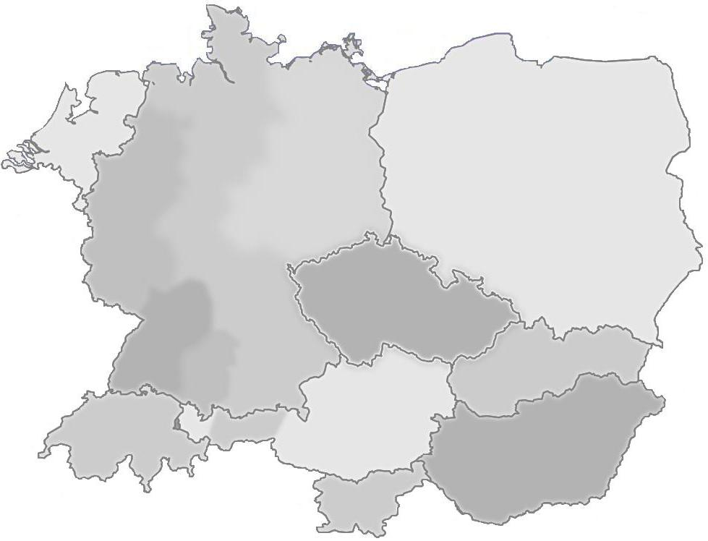
Example of one critical situation -3/12/2011
Power
surplus
1000 MW
1500 MW
4000 MW
2000 MW
8500 MW
Power shortage

Slide 8
ČEPS’ Remedial actions
Solutions to strengthen transmission grid
  Long-term = robust transmission infrastructure developed hand in hand with RES development
  Medium-term = phase shifting transformers
  Short term = permanent strengthening and reconfiguring of network elements + redispatch
  + overcurrent protection on the CZ-DE border
To cooperate within regional operational platform
To promote further integration of national markets
To secure non-discriminatory treatment within the CEE region = appropriate size of market areas

Slide 9
What would help
Shortening of permission procedures for network construction
Compliance of RES construction with
grid capacity
State responsiblity for impact of national policies on other countries
Unplanned flows
Rules
Support
Network
Coherent EU policy
Foreseeable
Stable in long term
Intergovernment agreements needed

Slide 10
Protection of critical infrastructure
  ČEPS is a natural part of critical infrastructure throughout the Czech Republic and all Europe
  Preparedness for crises and emergencies
  Regular training for emergency situation response
  Relevant structure in place
  ČEPS incorporated in Crisis and Emergency Planning System (field and table top exercises)
  Agreements to cooperate with Fire Rescue Services and with Police for civil emergencies
  Defense planning with the Army

Slide 11
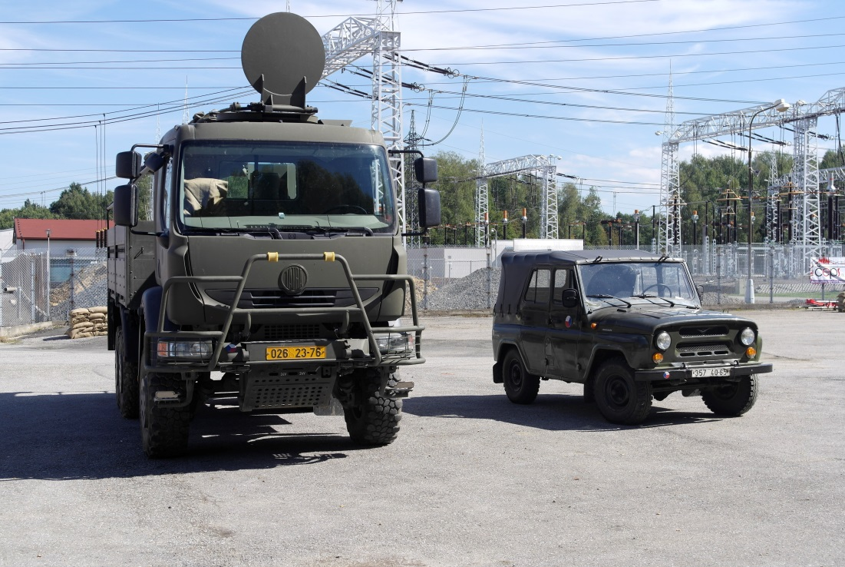
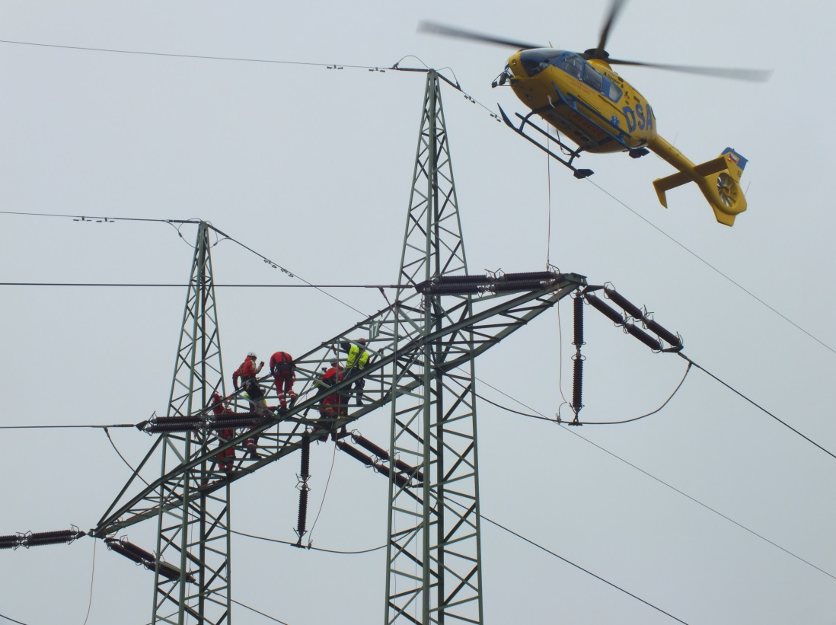
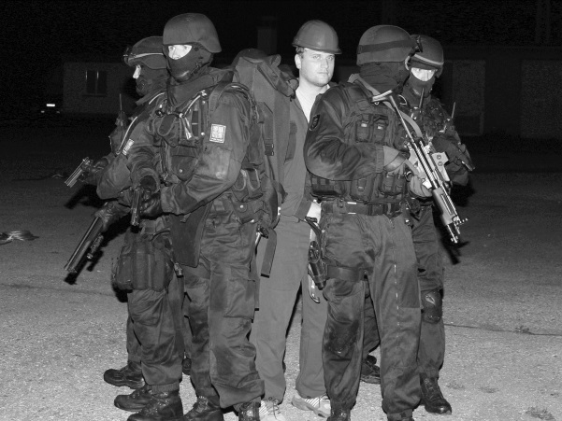
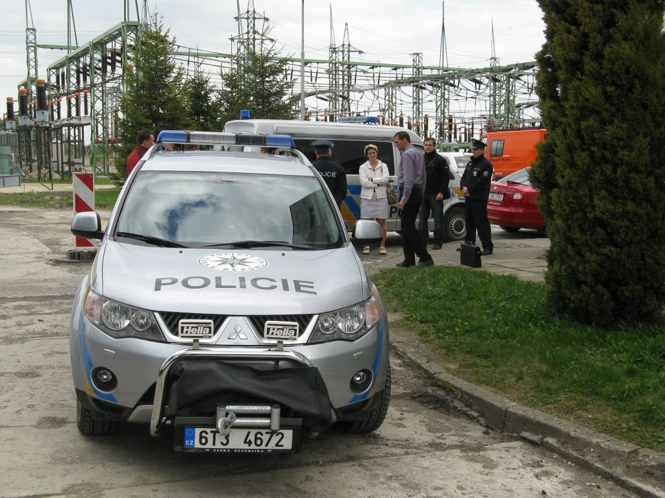
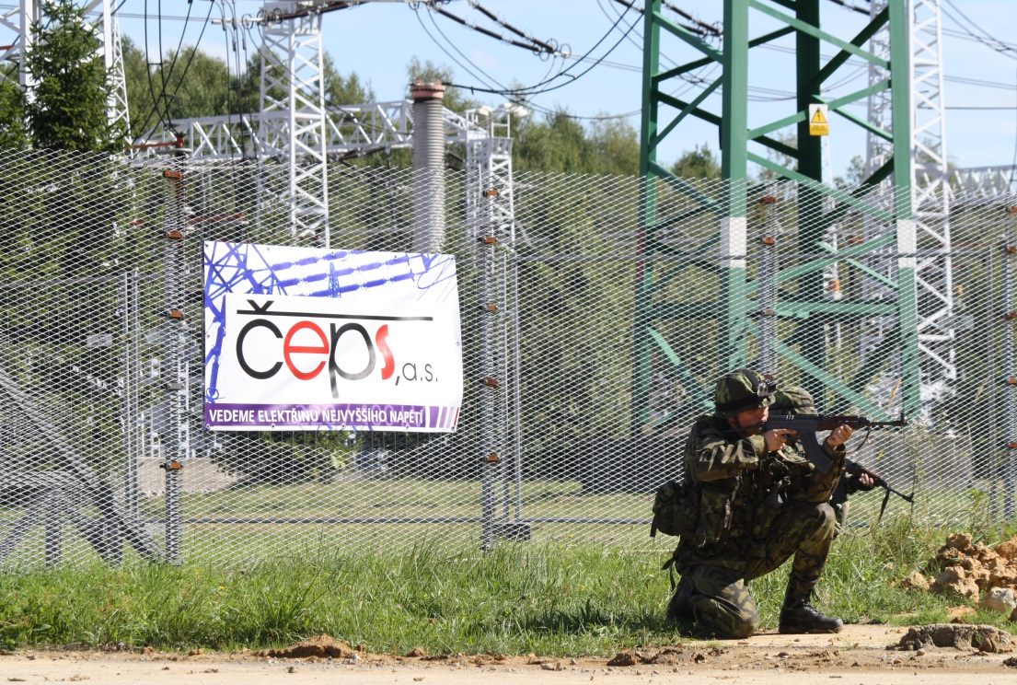

Slide 12

Conclusions
As the current process of RES integration is ahead of network infrastructure construction, this increases the risk of a blackout
Ensuring secure operation is an imperative for further market and RES integration
Present development leads to limitation of market competition due to competition between different types of subsidies
TSOs have to protect their infrastructure

Slide 13
Well unbundled connectivity
Zbyněk Boldiš
Member of the Board
ČEPS, a.s.
Elektrárenská 774/2
Praha 10
boldis@ceps.cz
www.ceps.cz

